Slide 1
Addressing the Opioid Epidemic for Adolescents in Austin/Travis County
Stephanie Rainbolt, Chair, Austin/Travis County Youth Substance Abuse Prevention Coalition
Vanessa Sarria, Vice President, Cardea - Austin Office

Slide 2
Drug Use Starts Early and
Peaks in Adolescence

Slide 3
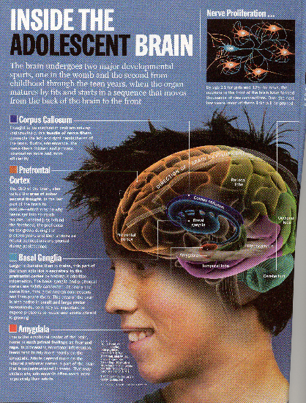
Adolescence is a period of profound brain maturation.
We thought brain development was complete by adolescence
We now know… maturation is not complete until about age 25.

Slide 4
During adolescence, the developing dopamine system is “robust”
This creates a greater risk of the dopamine hijacking process for the developing brain, compared to an adult brain

Slide 5
Accidental Poisoning Deaths among 15-24 Year Olds in Texas: 1999-2015
Source: Texas Death Certificates
Accidental Poisonings based on County of Occurrence
Prepared by Texas Department of State Health Services, Center for Health Statistics 3/6/2018

Slide 6
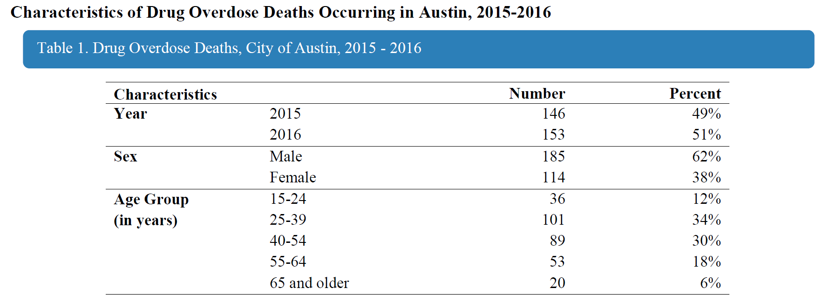
Overdose Deaths in Austin 15 to 24 age group
Source: Epidemiology and Disease Surveillance Unit, Epidemiology and Public Health Preparedness Division – Sept. 2017

Slide 7
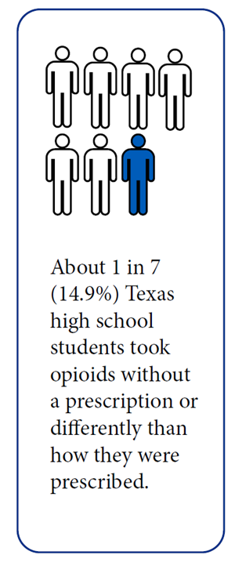
YRBS Data
Source: Illicit Drug Use; Texas Department of State Health Service; Texas Youth Risk Behavior Survey, January 2018

Slide 8
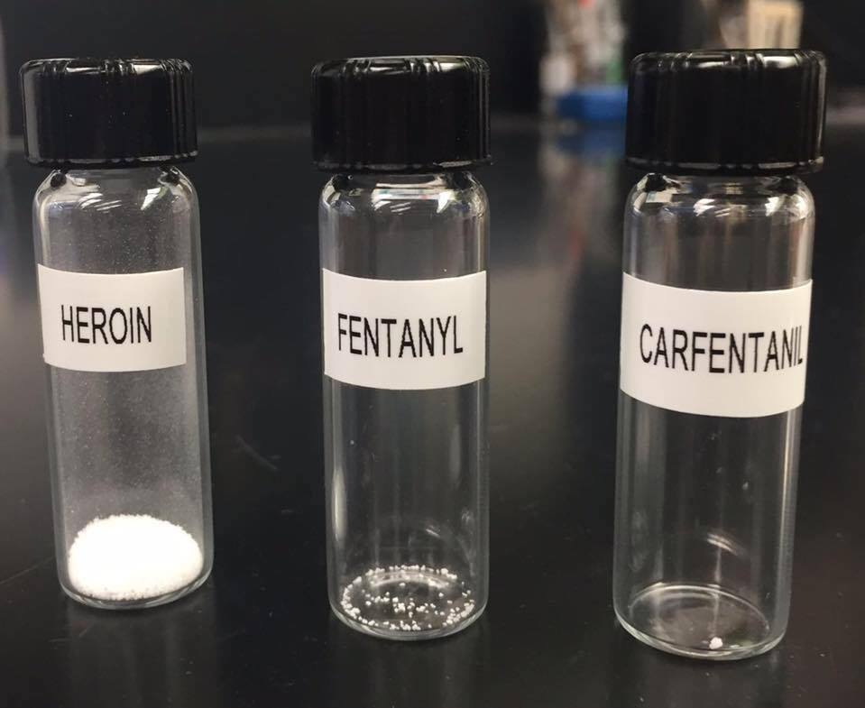
Dangers of Drugs Laced with Opioids
Notes:
Opioids are derived from opium poppies, a plant that secretes opium when the outer bulb is cut
Morphine was synthesized in 1803 and was utilized for pain management and surgical anesthesia
Bayer marketed heroin in 1895 for opium and morphine addiction
The chemical structure of heroin is nearly identical to morphine but with better brain penetration
Vicodin was approved by FDA in 1976, then was the most prescribed drug in U.S. from 2006-2013

Slide 9
Trends to Watch: Adolescent Girls/Women
Adolescent girls 12 to 17 are more likely than boys in that age group to use all psychotherapeutics, including pain relievers, for nonmedical reasons.
Among nonmedical users, girls in this age range are more likely to become dependent.
Between 1999 and 2010, overdose deaths from prescription painkillers increased more than 400% among women, compared to an increase of 237% among men.
Women who are caregivers may face additional barriers to treatment for substance.
Source: Final Report: Opioid Use, Misuse, and Overdose in Women, July 19, 2017, Office on Women’s Health

Slide 10
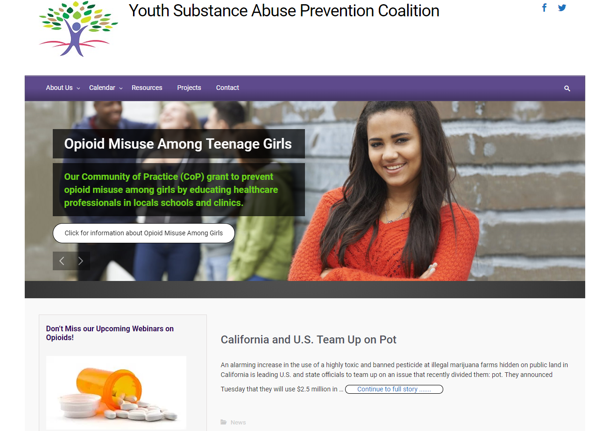

Slide 11
Topics of Interest
Understanding addiction and adolescent brain development
Overview of opioids (how different from other drugs)
Data, story and trends
Recognizing warning signs
How to talk to adolescents
Motivational Interviewing
How and when to screen for misuse
Gender-responsive, culturally relevant approaches/tools
Trauma-informed approaches/tools
Evidence-based prevention interventions
Information and referral to local resources
Ways to integrate prevention into primary care/behavioral health

Slide 12
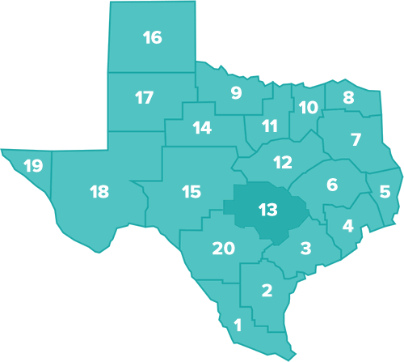
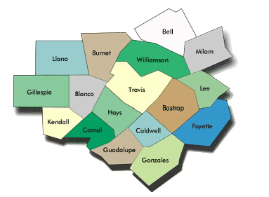
Where?
Schools in TEA Region 13
Community Health Centers in Travis County

Slide 13
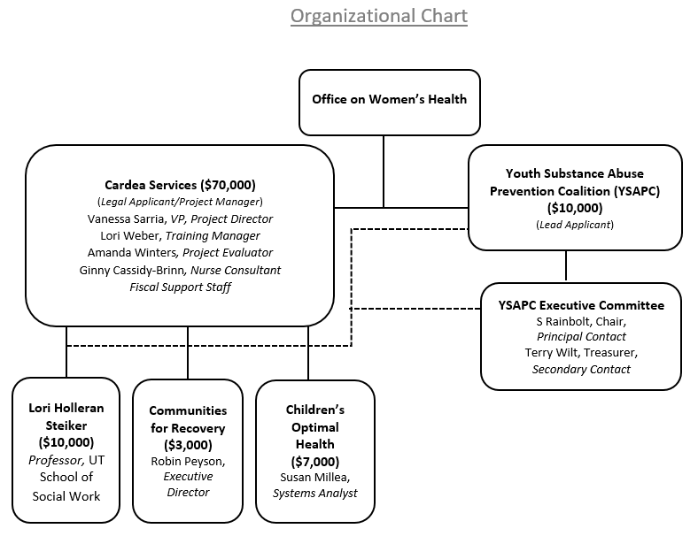
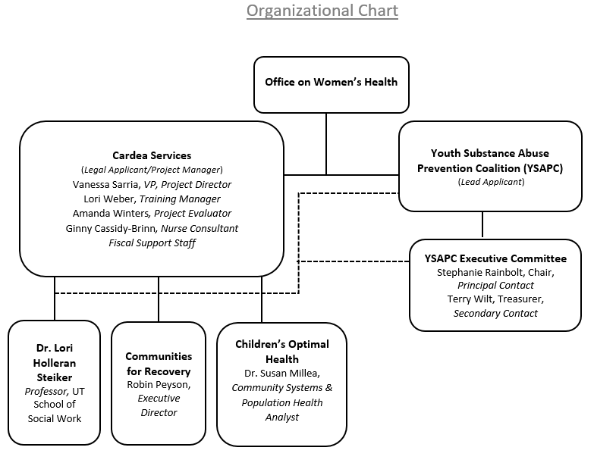

Slide 14
Partners (signed support letters)
Austin ISD
Austin Public Health
Central Health / CommUnityCare / CommunityCare Collaborative / Sendero Health Plans
Children’s Optimal Health*
Communities for Recovery*
Dell Children’s Medical Center of Central Texas
El Buen Samaritano
Integral Care
LifeWorks
Manor ISD
Operation Naloxone
People’s Community Clinic
Region 13 Education Service Center
Texas Overdose Naloxone Initiative
UT School of Social Work*

Slide 15
CoP Timeline
Fall 2017 – 20 informant interviews completed
March 22, 2018 - Region 13 Face to Face Training (Opioid Misuse in Adolescents: Prevention and Detection)
May 4, 2018 – CoP Webinar #1 (Opioid Misuse in Adolescents: Prevention and Detection)
May 22, 2018 – Meeting with Outreach, Screening, Assessment, Referral organizations
May 30, 2018 – TA Calls with School Nurses from Region 13
June 7, 2018 – Focus Group with Clinicians from Community Health Centers
June 21 – Region 13 School Nurse Conference
Aug/Sept 2018 – CoP Webinar #2
Feb/March 2019 – CoP Webinar #3
July/Aug/Sept 2019 – CoP Webinar #4
Jan/Feb/March 2020 – CoP Webinar #5
April/May/June 2020 – CoP Webinar #6
Quarterly technical assistance calls (health professionals in schools/clinics rotate)

Slide 16
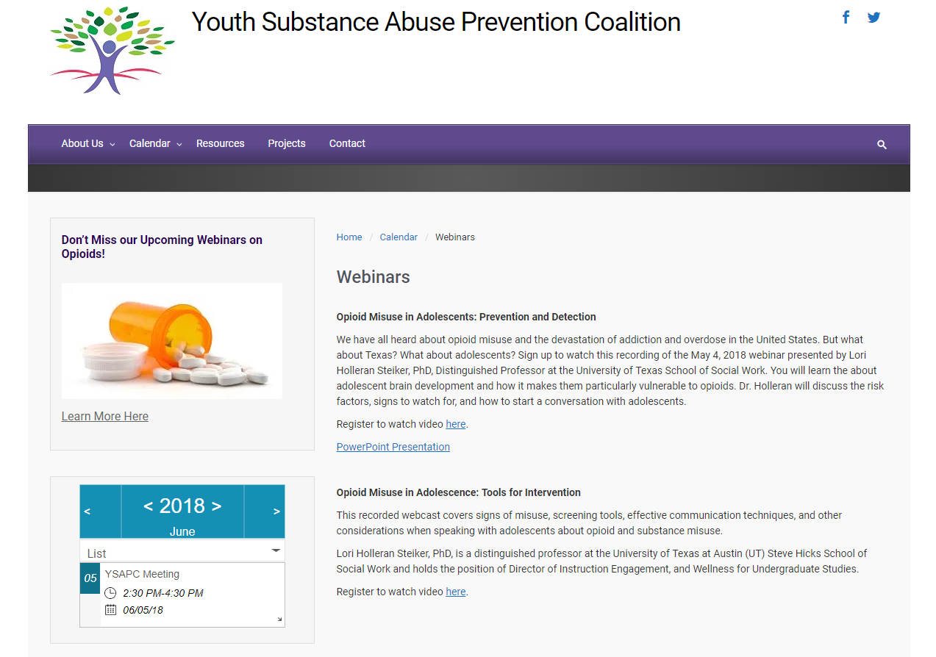

Slide 17
Contact Information
Vanessa Sarria, MPA
Vice President
Cardea
Vsarria@cardeaservices.org
www.cardeaservices.org
Stephanie Rainbolt, M.Ed., ACPS Program Director, Next Step/Teen Parent Services
LifeWorks
stephanie.rainbolt@lifeworksaustin.org

