Slide 1
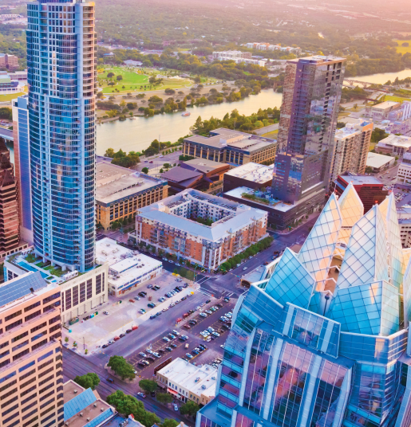
2019 State Legislative Update
Intergovernmental Relations Office
Brie L. Franco

Slide 2
2019 Texas Legislature: by the numbers
Year | Total Bills Introduced | Total Bills Passed | City-Related bills introduced | City-Related bills passed
76th-1999 | 5,813 | 1,622 | 1,230+ | 130+
… | … | … | … | …
84th-2015 | 6,476 | 1,329 | 1,900+ | 220+
85th-2017 | 6,800 | 1,208 | 2,500+ | 294
86th-2019 | 7,324 | 1,429 | 2,300+ | 338
3,970 Bills/JR’s filed in last 10 business days before filing deadline (54%)
1,296 Bills/JR’s tracked by IGRO
2

Slide 3
The Agendas
Abbott
Property tax reform, school finance reform, school safety, mental health, and disaster response
Patrick
Property tax reform, school finance reform, free market protection, and taxpayer funded lobbying
Bonnen
Property tax reform, school finance reform, school safety, and combating human trafficking

Slide 4
Revenue Caps
Reduces the rollback rate from 8% to 3.5% effective January 1, 2020
Election required to exceed 3.5%
No credit for local optional homestead exemption
City may not decrease the compensation in FY 2020 to which a first responder was entitled to in the preceding year
8% voter-approval rate still applies to all special taxing units:
a taxing unit other than a school district for which the maintenance and operations tax rate proposed for the current tax year is 2.5 cents or less per $100 of taxable value;
a junior college district; or
a hospital district.

Slide 5
Cable Franchise Fees: SB 1152
SB 1152 mandates that the City may collect either a telecommunications or cable franchise fee from companies that provide both services, whichever is greater; the City currently collects both fees
$4 million reduction in City revenues in FY 2020; $5.6 million annual reduction in subsequent years
Law becomes effective September 1st, 2019

Slide 6
General Fund Base Forecast
$58.2 million deficit
at 3.5% in FY24
$18.5 million deficit
at 3.5% in FY21
Revenue forecast reflects lower revenue cap and $5.6 million reduction in franchise fees.
Expenditure forecast reflects 30 officers per year and 1 new Fire/EMS station opening per year.

Slide 7
Texas Legislature Lens: Priority Issues
Austin Energy
Revenue Caps
Red Light Cameras
Zoning / Short-term Rentals
Employees’ Rights and Benefits
Bathrooms
Super Preemption
Austin Water
Planned Parenthood
Annexation Part II: ETJ Regulation
No City Lobbying
Cable Fees

Slide 8
What Passed: Bills With A Negative Impact
“Save Chick-fil-A” (SB 1978)
Historical designation (HB 2496)
Board of Adjustment (HB 2497)
Regulation of building materials (HB 2439)
Land development applications (HB 3167)
Annexation Part II / Shady Hollow and SPAs (SB 1468)
Planned Parenthood (SB 22)

Slide 9
What Passed: Bills With A Positive Impact
Sgt. Jonathan J. Dunbar memorial highway (SB 1134)
Richard Overton memorial highway (HB 1821)
Sobering center (SB 306)
Waste worker safety (HB 61)
Recyclable materials (SB 649)
Texas Facilities Commission ledger (HB 2977)
Texas State Library and Archives Commission easement (HB 2978 / HB 1962)
Save Historic Muny District (SB 2553)
Landlord flooding disclosure (HB 3815)

