Slide 1
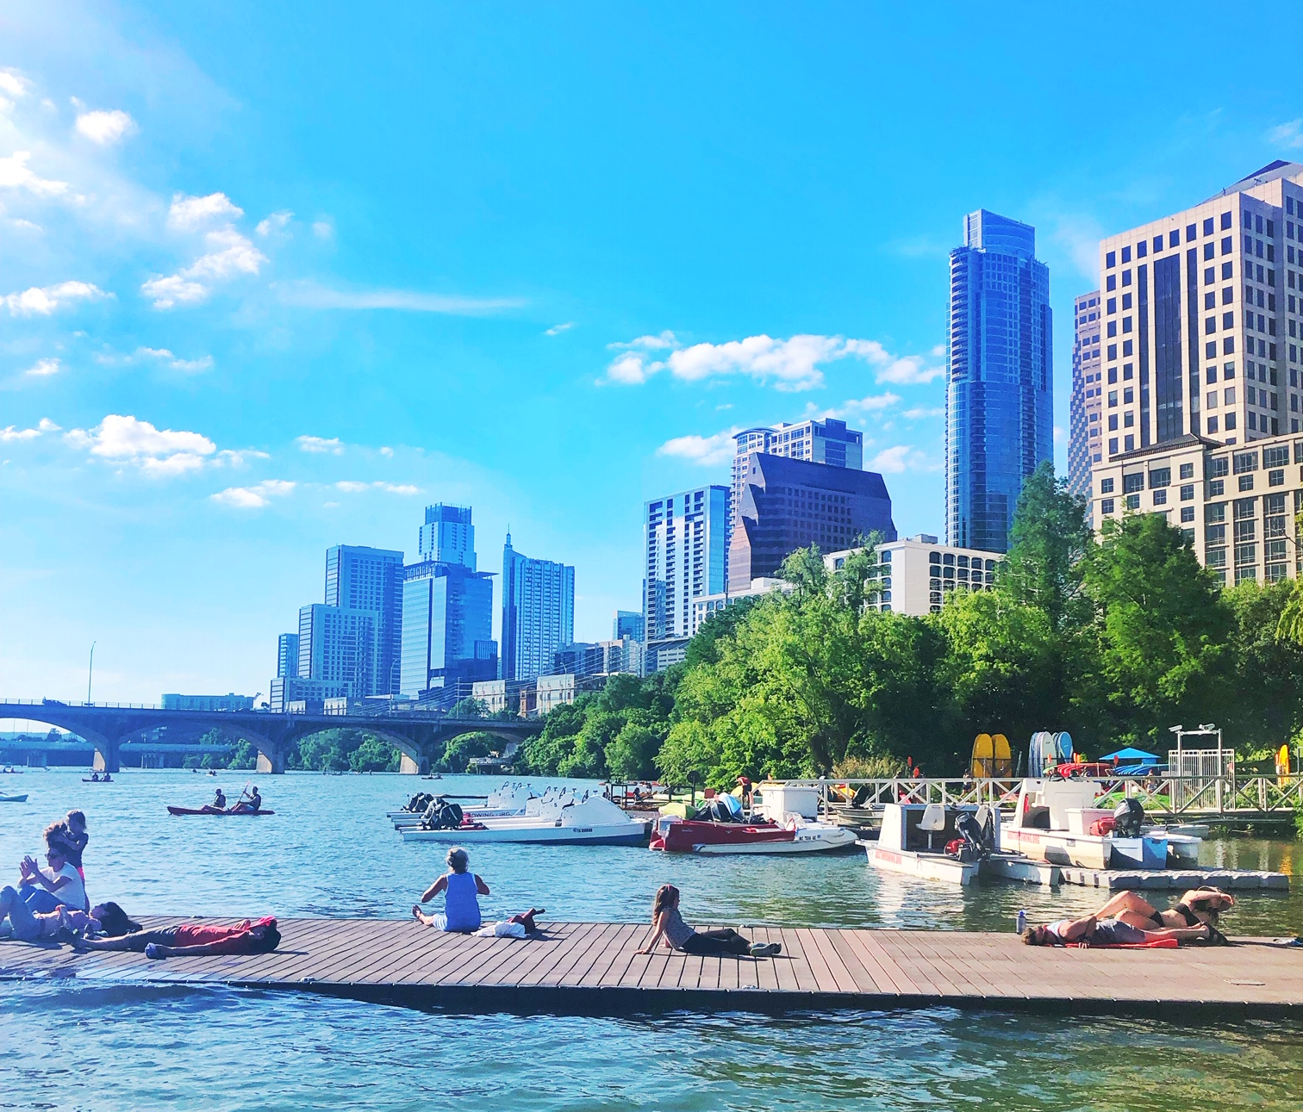

Slide 2
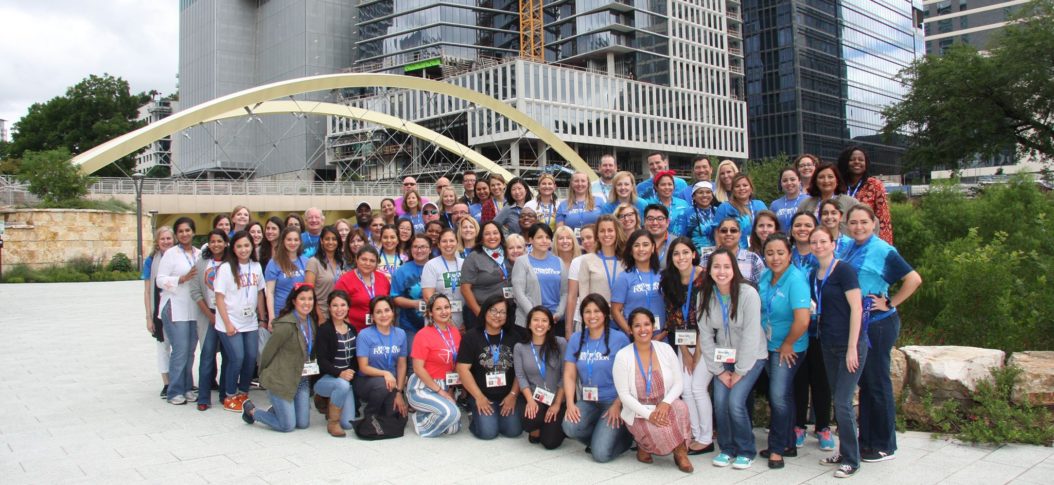
St. David’s Foundation is one of the largest health foundations in the United States, funding $70 million annually to over 65 grant partners in Central Texas.
Mission: To create healthier lives for all Central Texans by addressing the region's top health challenges, with the goal of building the healthiest community in the world.

Slide 3
ST. DAVID’S NEAL KOCUREK SCHOLARSHIP
Class of 2019 – 61 Scholars
Notes:
Highlights from this program:
More than 500(?) scholarships given out since inception
Current class includes 2 former scholars who are now mentors
current class includes 5 (or 6?) legacies

Slide 4
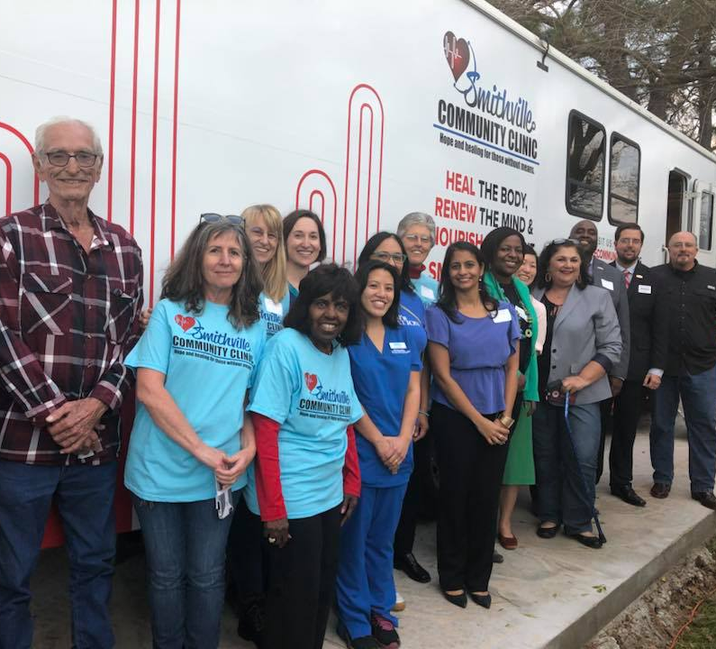
DONATION OF RETIRED DENTAL VANS
Community Health Centers of South Central Texas - Elgin, People’s Community Clinic, Smithville Community Clinic
Notes:
Use this slide to tee up your presentation. In cases where you are presenting to a group who does not know you or the Foundation, use this space to establish yourself as a subject matter expert, or introduce the Foundation and your expertise.

Slide 5
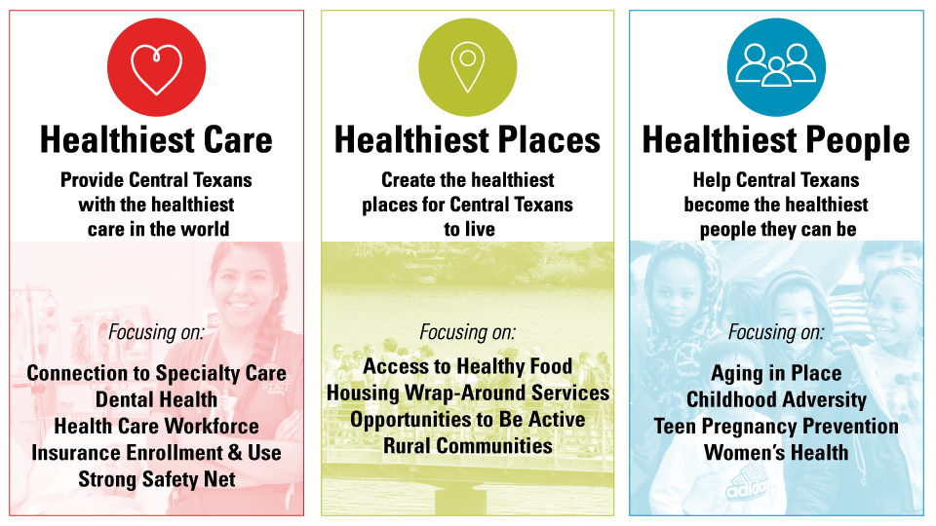
Strategic Priorities
Notes:
Use this slide to tee up your presentation. In cases where you are presenting to a group who does not know you or the Foundation, use this space to establish yourself as a subject matter expert, or introduce the Foundation and your expertise.

Slide 6
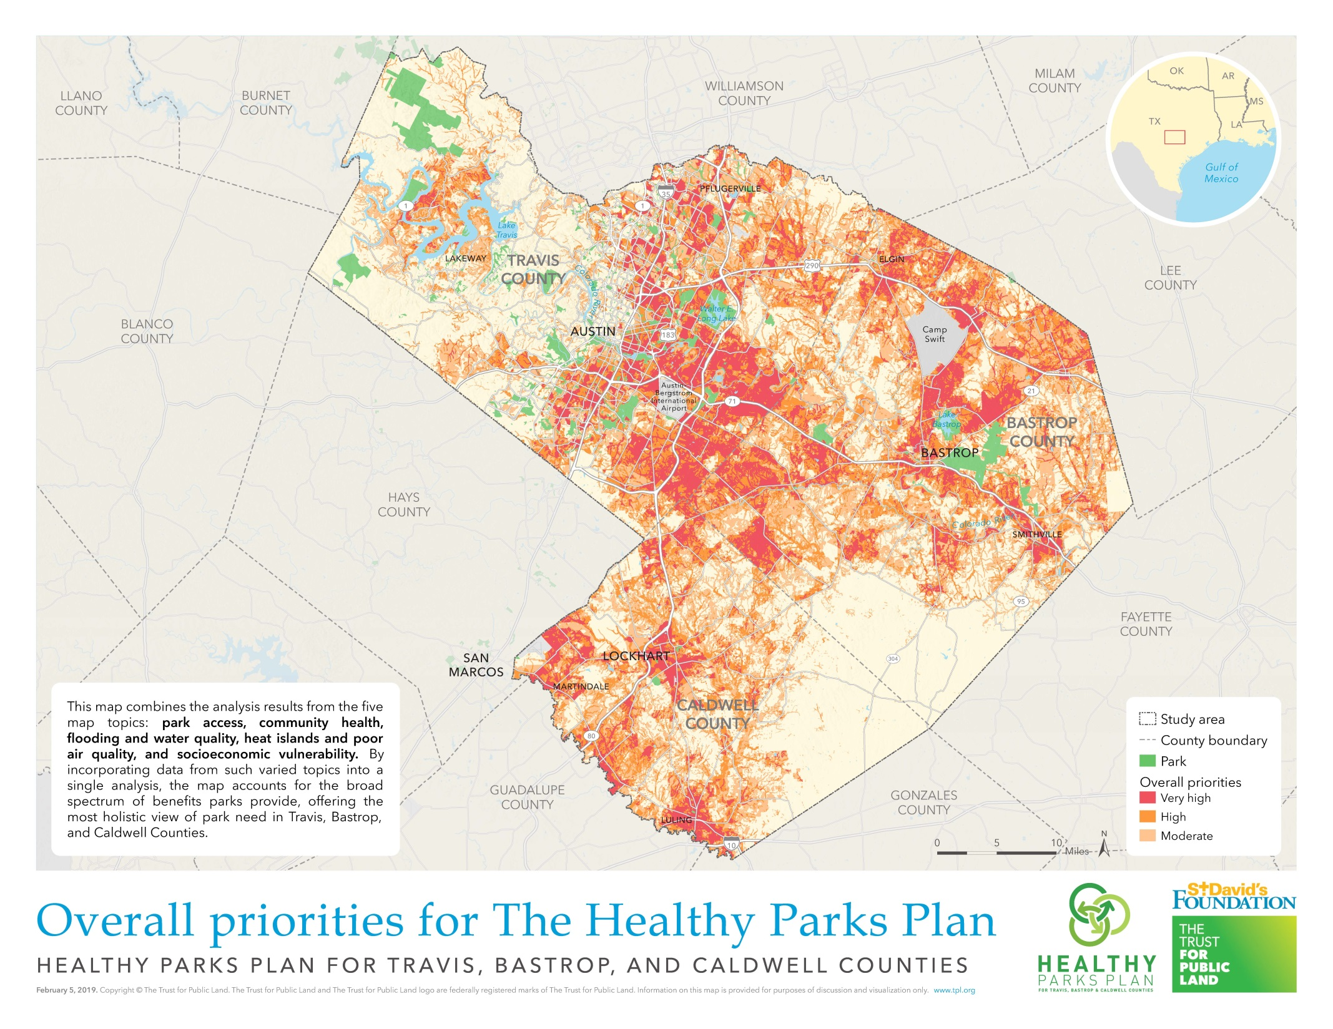
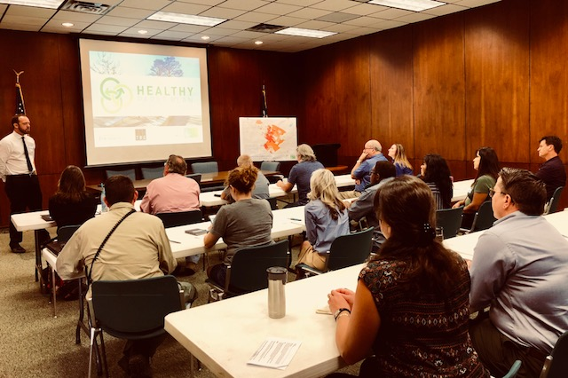
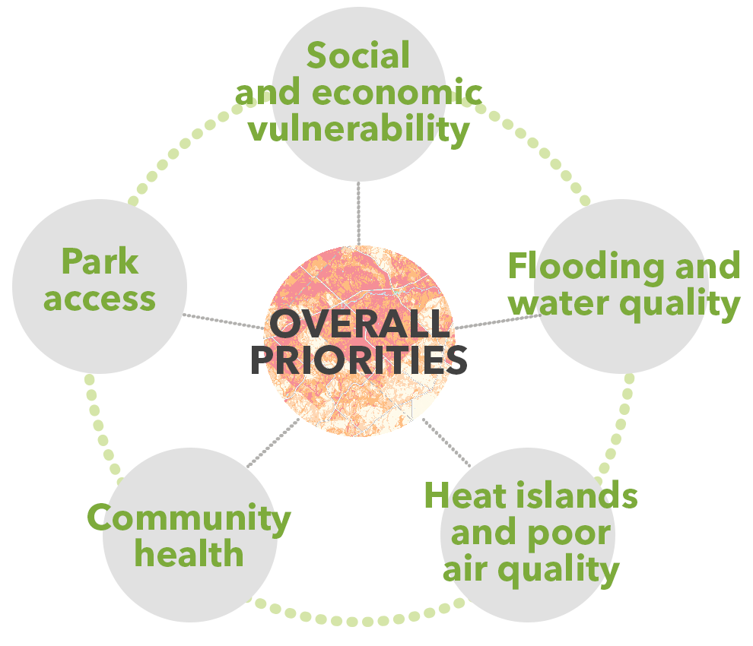
PARKS WITH PURPOSE
Healthy Parks Plan and Request for Proposals
www.stdavidsfoundation.org/grantmaking/fundingopportunities
Notes:
Use this slide to tee up your presentation. In cases where you are presenting to a group who does not know you or the Foundation, use this space to establish yourself as a subject matter expert, or introduce the Foundation and your expertise.

Slide 7
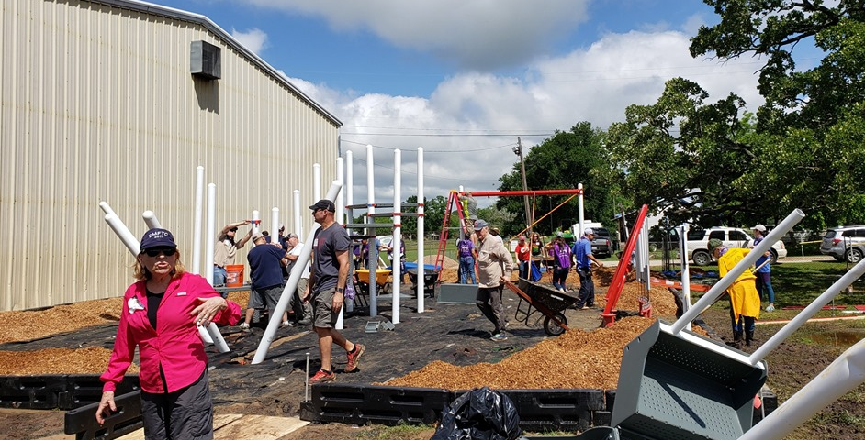
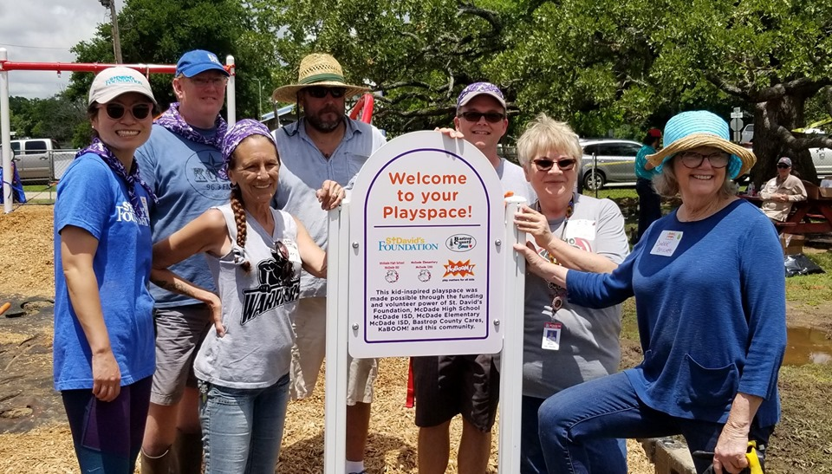
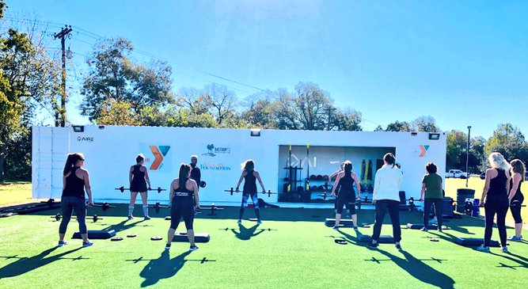
With McDade ISD, Bastrop County Cares, Bastrop YMCA
BUILDING COMMUNITY WHILE IMPROVING PARKS
Notes:
Use this slide to tee up your presentation. In cases where you are presenting to a group who does not know you or the Foundation, use this space to establish yourself as a subject matter expert, or introduce the Foundation and your expertise.

Slide 8
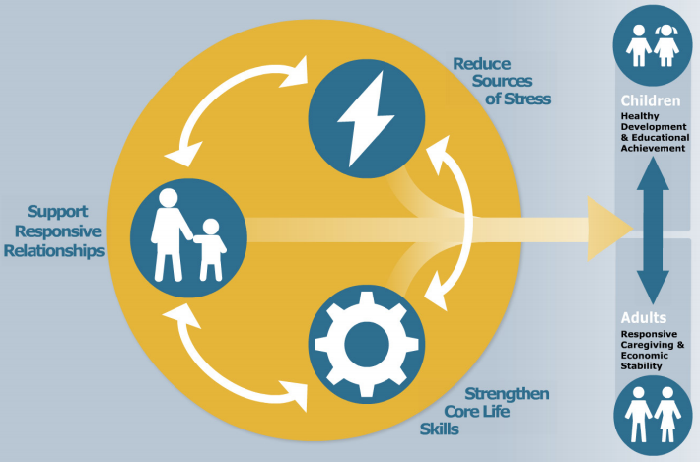
PREVENTING CHILDOOH ADVERSITY
AND BUILDING COMMUNITY RESILIANCE
Notes:
Use this slide to tee up your presentation. In cases where you are presenting to a group who does not know you or the Foundation, use this space to establish yourself as a subject matter expert, or introduce the Foundation and your expertise.

Slide 9
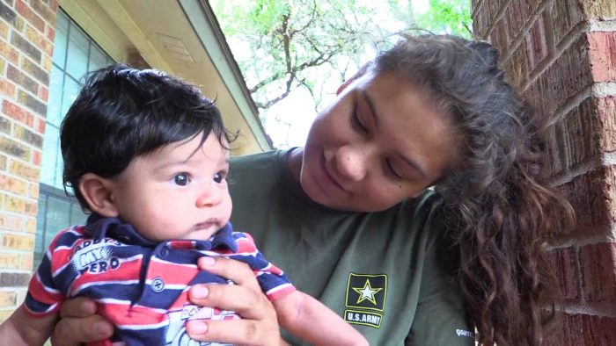
BRINGING FAMILY CONNECTS TO TRAVIS COUNTY
With United Way and St. David’s South Austin Medical Center
Notes:
Use this slide to tee up your presentation. In cases where you are presenting to a group who does not know you or the Foundation, use this space to establish yourself as a subject matter expert, or introduce the Foundation and your expertise.

Slide 10
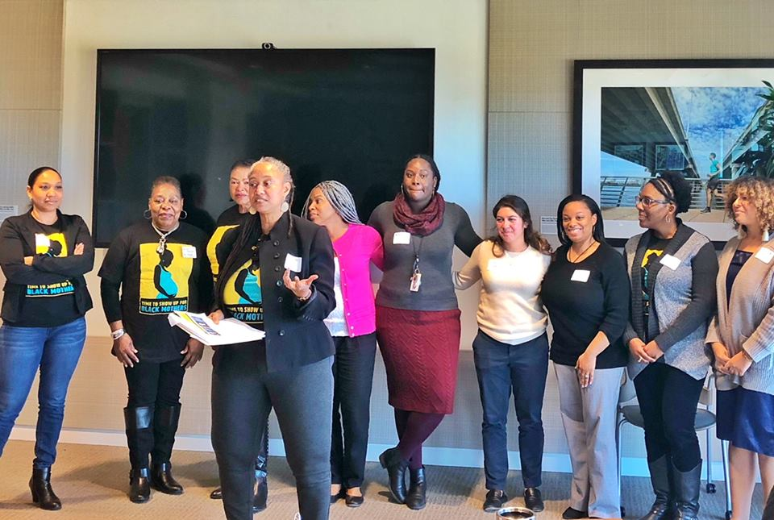
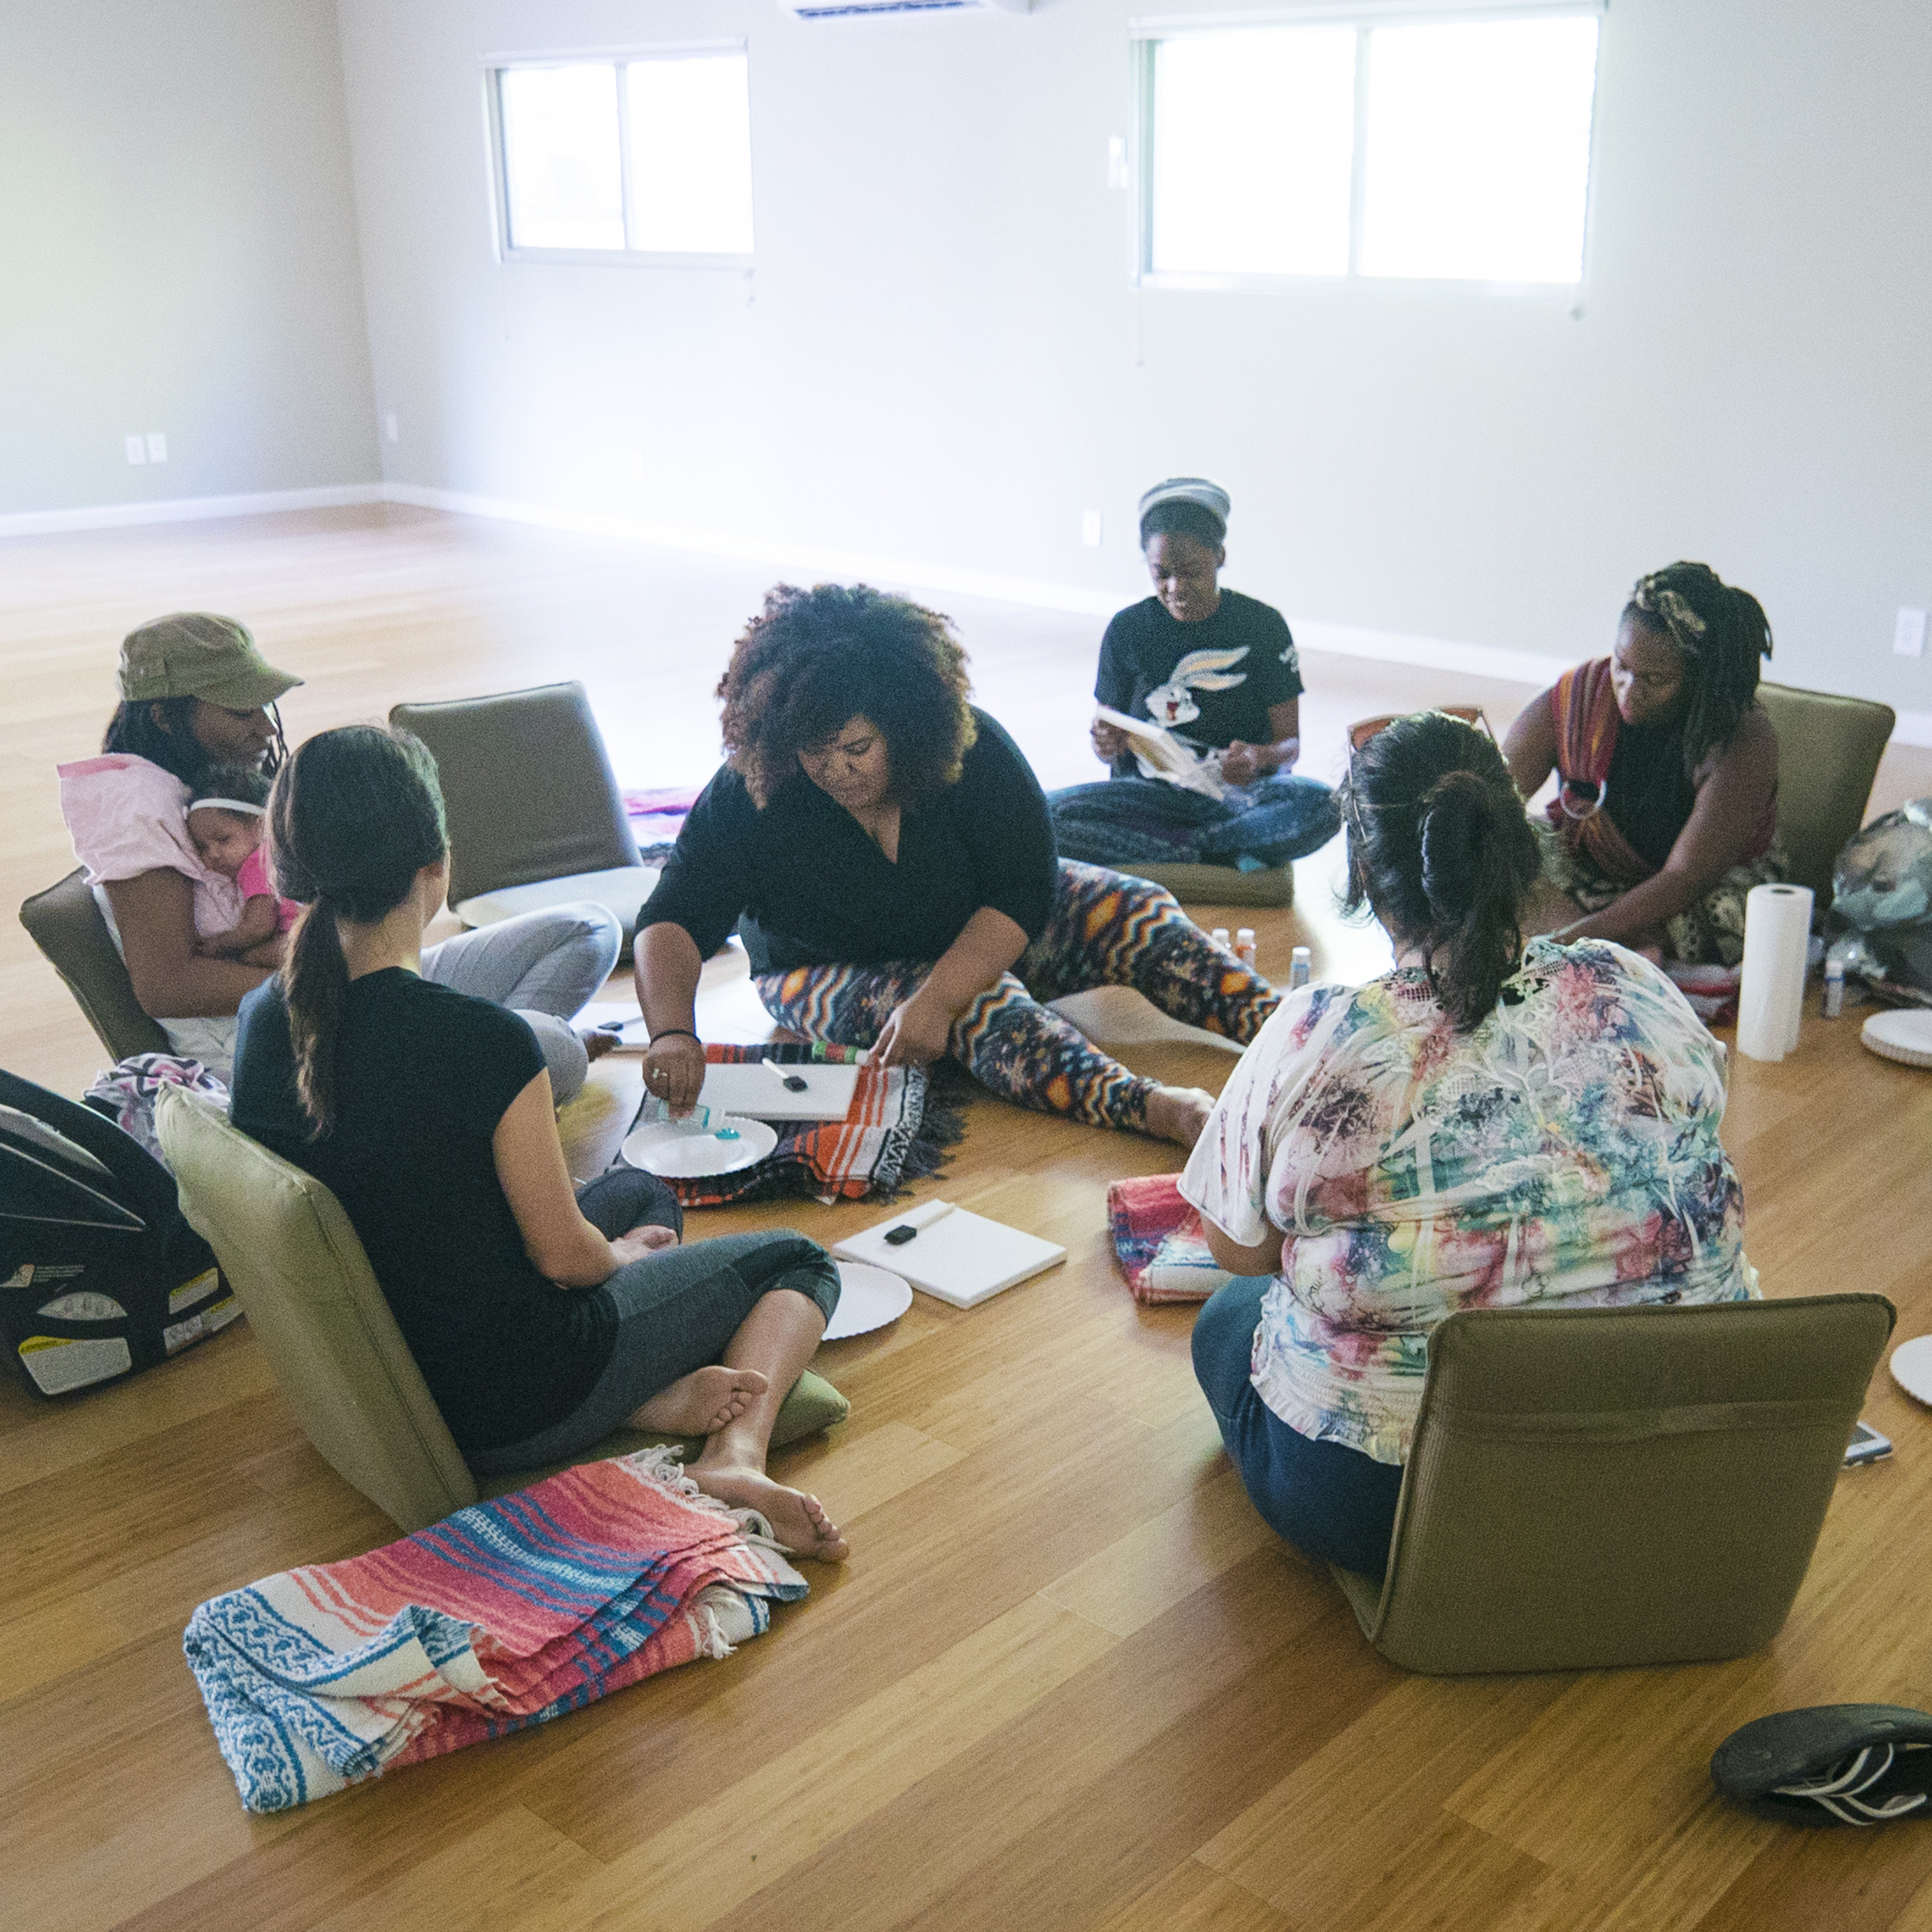
FOCUSING ON THE FOURTH TRIMESTER
12 Organizations Improving Maternal Health Equity in the Postpartum Period
Notes:
Use this slide to tee up your presentation. In cases where you are presenting to a group who does not know you or the Foundation, use this space to establish yourself as a subject matter expert, or introduce the Foundation and your expertise.

Slide 11
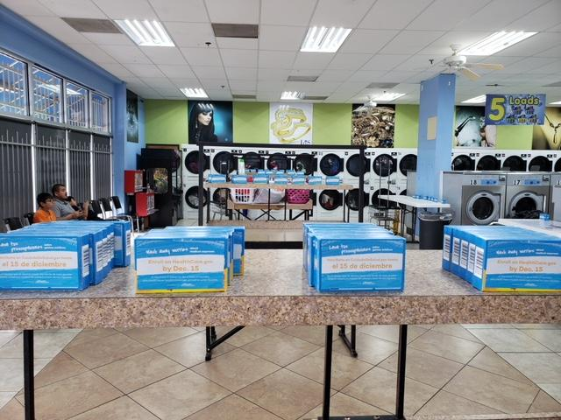
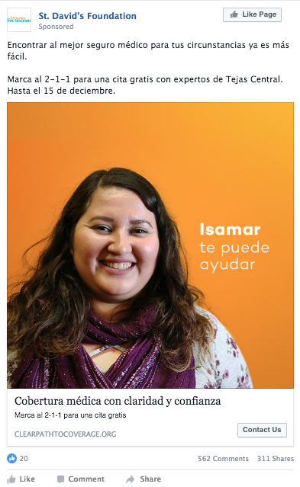
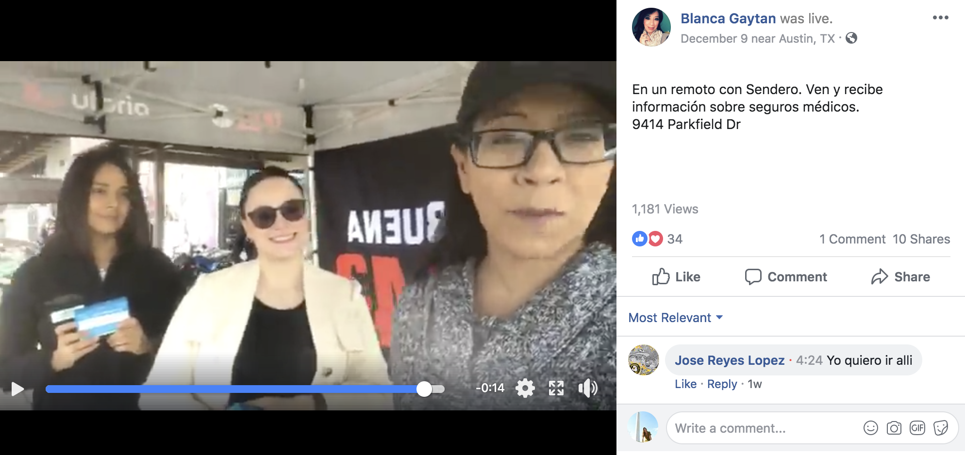
GETTING THE WORD OUT: ACA ENROLLMENT
Census Coming Soon
“Wash Away” Laundromat Event
Notes:
Use this slide to tee up your presentation. In cases where you are presenting to a group who does not know you or the Foundation, use this space to establish yourself as a subject matter expert, or introduce the Foundation and your expertise.

Slide 12
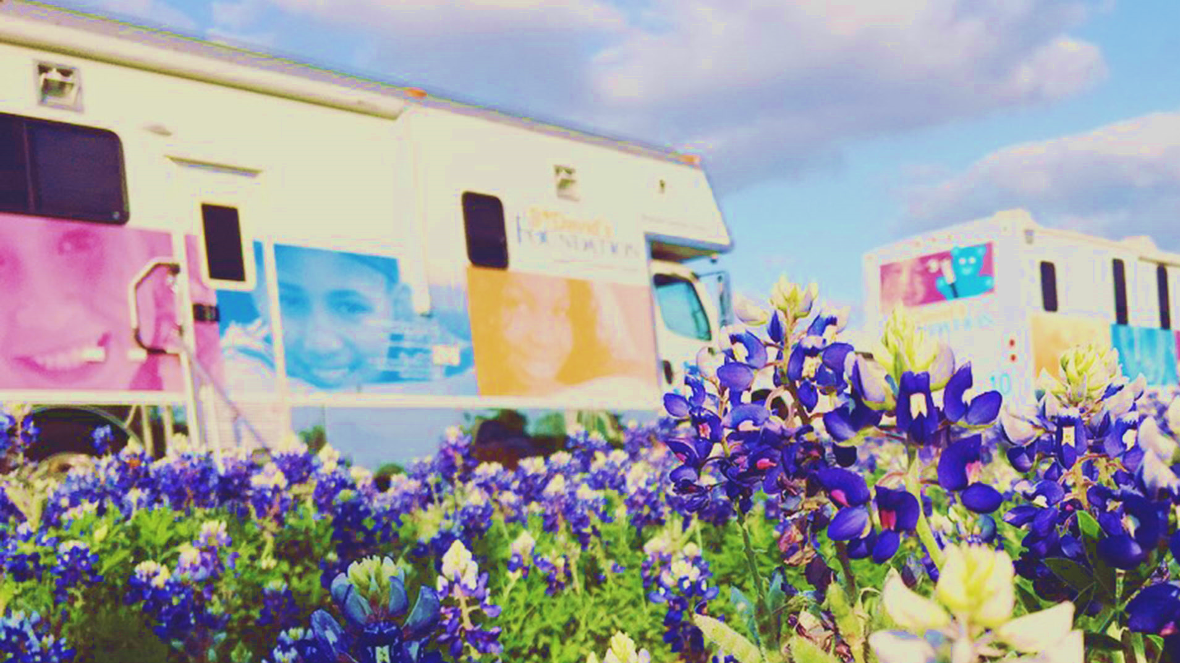
Notes:
The closing picture should compliment or be the same image as the opening slide.

