Slide 1
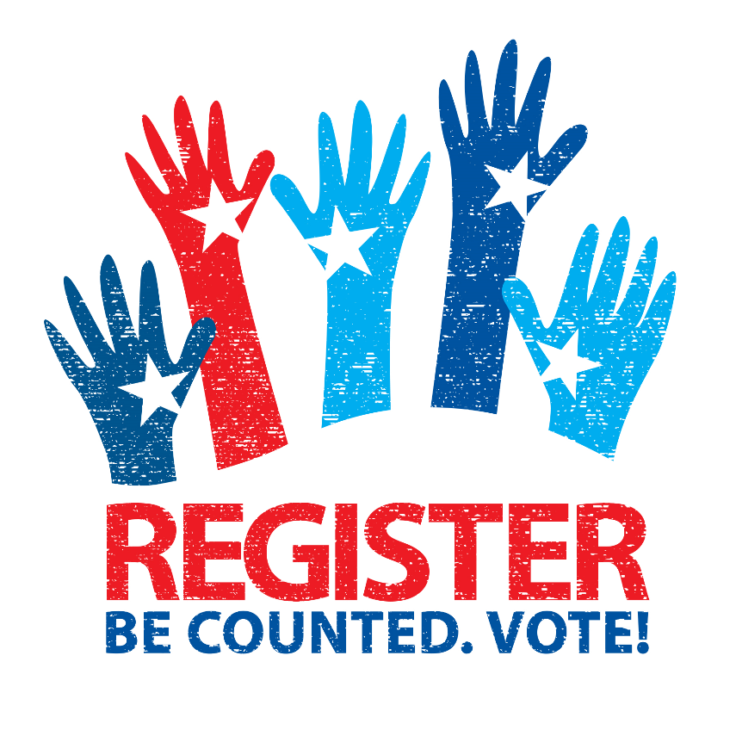
Motivating
Young
People
Voter registration in travis County

Slide 2

Graduation Week 2017, AISD invited Voter Registration to have VDRs present to register all eligible new graduates. This will expand to other school districts in Travis County next year.

Slide 3


First Vote Program is a collaborative effort with the League of Women Voters in Austin and the Travis County Clerk’s Elections Division.
Plan is to visit all high schools
in Travis County to introduce
voter registration and the
elections process. Students
eligible for registration are also
registered at that time.

Slide 4

Contest geared to Middle and High School Students of Travis County. This is promoting civic engagement within the school age population.

Slide 5
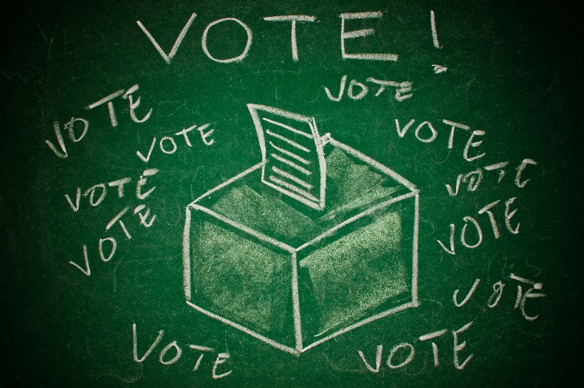
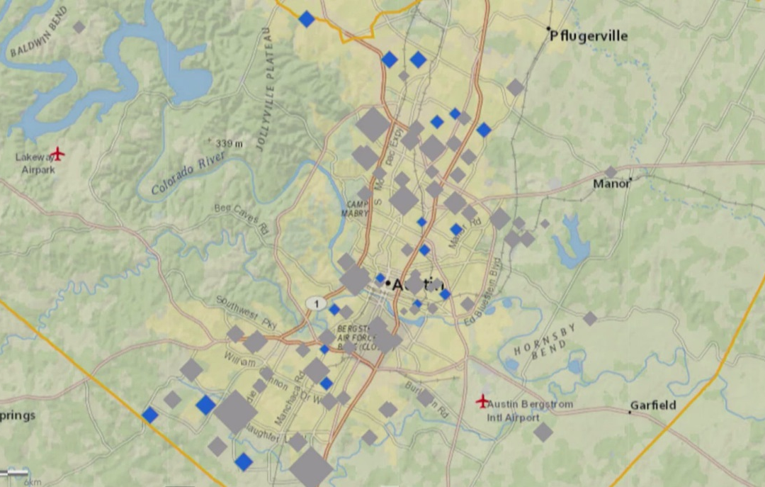
Presidential Mock Election 2016
All schools were contacted to participate and over 80 schools held registration efforts and an election.
Another mock election is planned for the General Election of 2018.

Slide 6
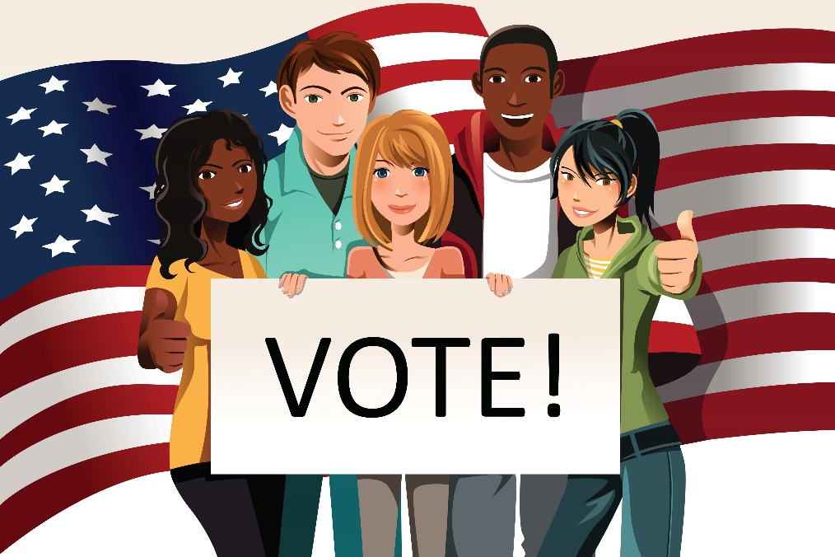
Voter Registration Campus Drives
AISD schools—during Back to School nights
ACC campuses—during Voter Registration month and back to school in January 2018
Residence Hall Fall move-ins at UT and Concordia
College campus’ staff and students became deputized to conduct registration activities
Partnerships with numerous campus organizations for registration outreach and training opportunities

