Slide 1
Service-Learning at Austin Community College
Linda Cox, Ph.D.

Slide 2
Service-Learning:
Service learning combines community service with academic instruction, focusing on critical, reflective thinking and personal and civic responsibility.
--The American Association of Community Colleges (AACC)

Slide 3
Service-Learning IS:
Service-Learning IS NOT:
It is tied to the course objectives.
Academic, critical reflection is required.
It is a service performed for a non-profit agency.
It is NOT (just) volunteerism.
It is NOT an internship.

Slide 4
What are the Benefits of Service-Learning?

Slide 5
Academic Benefits to Students reported in “Evidence of Service-Learning Benefits,” Carleton University. 28 April 2015. Web. 29 Dec 2015.
Improved student academic outcomes
Students are motivated to work harder
Students can apply what they've learned in the "real world”
Notes:
Improved student academic outcomes as demonstrated through complexity of understanding, problem analysis, critical thinking, and cognitive development. (Astin et al., Eyler et al., Eyler and Giles)
Students reported that they learned more and were motivated to work harder in a service-learning class then in traditionally taught classes. (Eyler and Giles)
Students and faculty report that service-learning improves students' ability to apply what they've learned in the "real world." (Astin et al., Eyler et al., Eyler and Giles)

Slide 6
Personal and Social Benefits to Students reported in “Evidence of Service-Learning Benefits,” Carleton University. 28 April 2015. Web. 29 Dec 2015.
Personal development
Interpersonal development
Reduce stereotypes and facilitates cultural and racial understanding
Increases commitment to service

Slide 7
How does ACC support Service-Learning?

Slide 8
ACC’s Office Service-Learning:
VISION:
The Service Learning and Civic Engagement Office at ACC will seek out opportunities to be a catalyst in transforming communities. The office will be recognized as an information hub for students, faculty, staff, and administration to develop and continue their community engagement.
MISSION:
The Service Learning and Civic Engagement Office seeks to foster student civic engagement, develop academic service-learning partnerships with non-profits throughout Central Texas as well as provide faculty with service-learning curriculum support.
Notes:
SCOPE:
Educate the ACC community about service learning.
Introduce agencies to interested faculty to initiate a service-learning relationship.
Advise faculty on implementation in their coursework.
Seek out agency partnerships and maintain an agency database.
Collect data about the implementation of service learning at ACC.
Recognize faculty and students that participate in service-learning initiatives.
Seek out grant and research opportunities.

Slide 9
EXAMPLES OF SERVICE-LEARNING AT ACC

Slide 10
SIGN LANGUAGE COURSES
The goal of this experience is to (apply) cultural and language skills by partnering with organizations that don't currently have relationships with the Deaf community …and address needs or gaps, from children … all the way through senior citizens.
Instructor: Lynne Wiesman

Slide 11
INTRODUCTION TO THERAPEUTIC RECREATION
Distance Learning Course
Students complete …fieldwork in a setting that provides Therapeutic Recreation for people with disabilities/special needs.
At the conclusion of fieldwork, students write a 2-3 page reaction paper about their experience and what they learned about Therapeutic Recreation and disabilities.
Instructor: Elizabeth M Salinas

Slide 12
ENGLISH COMPOSITION 1
…Through shared readings, discussions, and optional firsthand volunteer experience, students learn about the causal relationships underlying some of our most pressing problems. Students have the option to work with a variety of community partners, including those focused on environmental stewardship, education, poverty, homelessness, and immigration. Students may choose to write both about and for their community partners. Their written work is featured on the class website, Stone Soup Writers.
Instructor: Kazel Morgan

Slide 13
Frankie Hefley, Director, Cherry Creek Community Gardens:
"Thanks to everyone who came out for the workday. It was a beautiful day, and we accomplished so much, including getting the community plot planted with the volunteers from Dr. Kazel Morgan's class at ACC (who did an amazing job). Here's one of the volunteers bonding with a Texas spiny lizard--they affectionately named him Beyoncé."

Slide 14
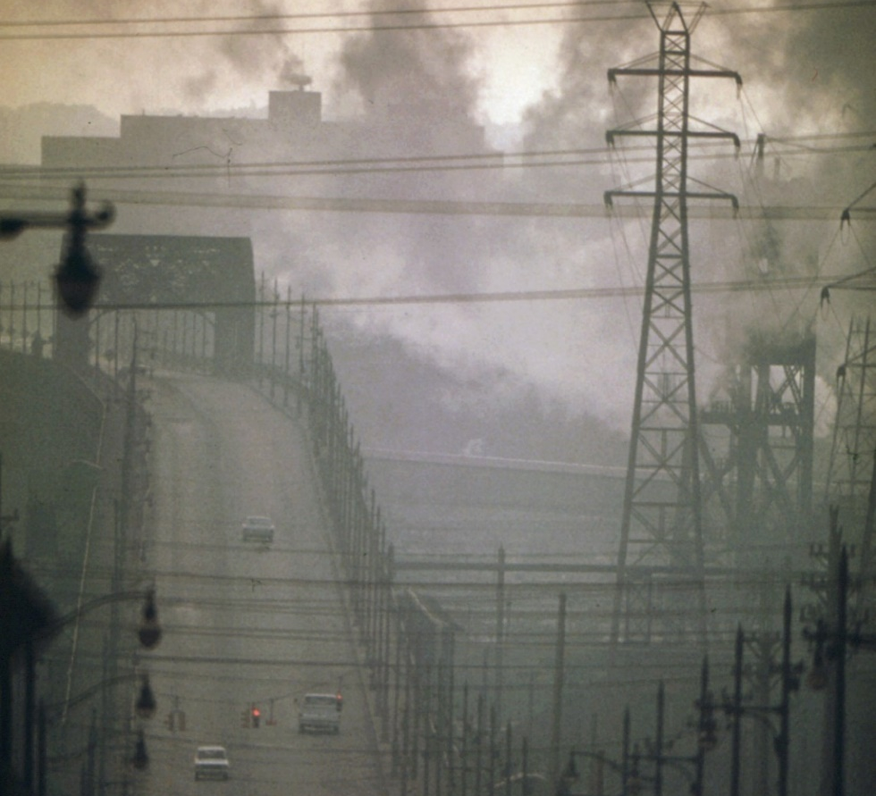
Conflict-Based Ethics
Focuses on:
Obligation or duty
Permissibility
Examples:
Do we have a moral obligation to protect the environment?

Slide 15
A Better Methodology: Problem-Based Ethics
Begins with an agreed-upon premise
Proceeds toward a solution through concrete actions and policies.
Example: Given that climate change is a problem we must solve, what is the most ethical solution to the problem?

Slide 16
ETHICS
Students apply theoretical ethical approaches to help solve local, practical problems in areas like environmental sustainability, women's incarceration, and hunger and food distribution. Students have opportunities to work directly with community partners to understand the complex issues first-hand, then reflect on their experiences and evaluate solutions.
Instructor: Linda Cox

Slide 17
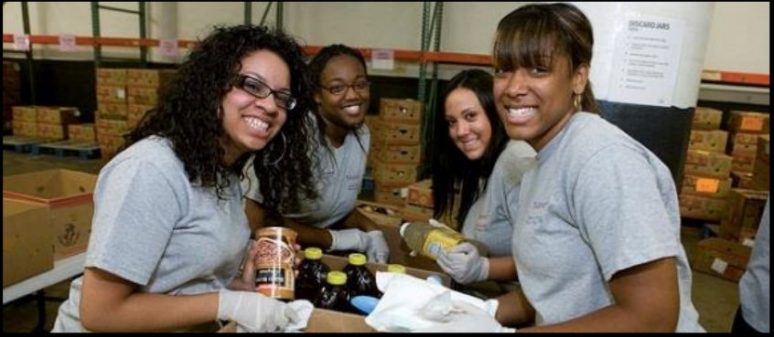

Slide 18
Connecting children with their incarcerated mothers through the joy of literature

Slide 20
ACC Office of Energy and Sustainability

Slide 21
Water usage at Pinnacle Campus

Slide 22
Students decide on an ethical question.
Students reflect on their answer to the question at several points along the way:
At the beginning
After reading general ethical theories
After reading ethical articles on their specific problem
After completing their service-learning experience

Slide 23
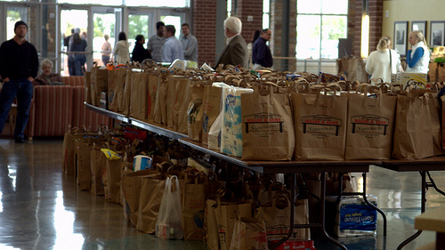
If I only knew then, what I know now!
My initial ethical problem focused on one solution for those who were “food insecure”.
Food banks have become the primary response for hunger and I initially thought that preserving the dignity of the patrons of area food banks [by limiting food given as charity] was a top concern.
Notes:
Here are four slides from a student presentation (Bailey Junot) that provide a very quick, thumbnail sketch of the process of service-learning my integrated ethics course. In my integrated service-learning class, I ask students to consider an problem like hunger in Hays county, and to reflect on what they think the most pressing ethical issue is. It is very common for students to think that food banks strip away the dignity of people who should work for themselves. We talk about dignity and trace it to its roots in Kantian theory, and we look at a number of other theories as well.

Slide 24
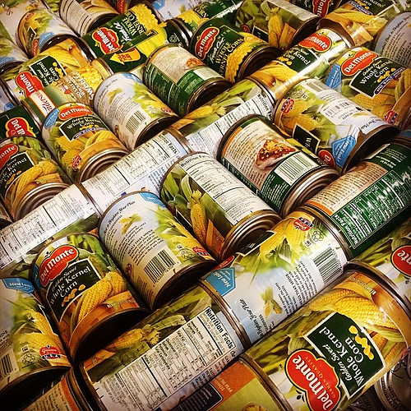
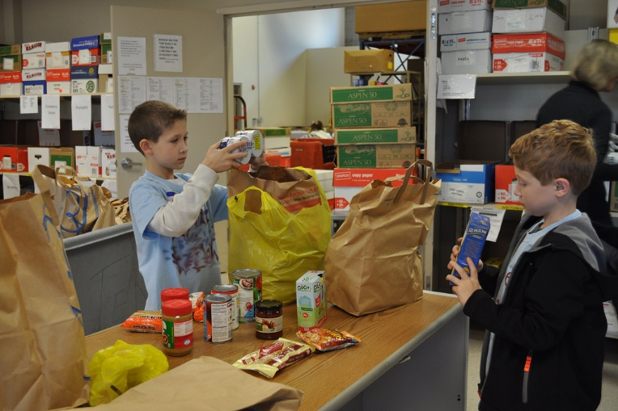
Hays County Food Bank
One in seven Hays County residents are food insecure.
Only 63% of the food insecure of Hays County are income – eligible for government nutrition programs like SNAP
My Service learning experience included:
Going to a local church and handing out food to families
Cleaning the food bank
Going through the food and throwing out expired goods
Notes:
Students are required to do research, which is important for utilitarian theory, and to complete their service-learning experience. This research helps students to understand the systemic problems and injustices at the root of the problems.

Slide 25
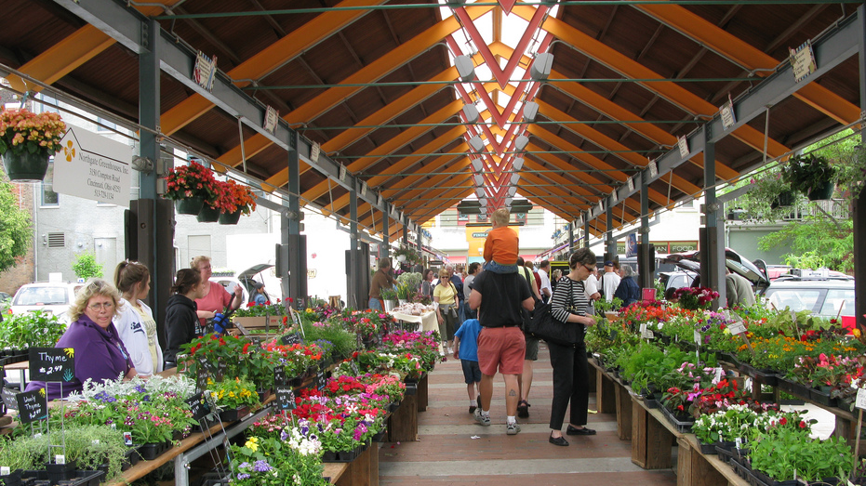
Theories/approaches solving world hunger:
The Care Ethical Approach involving the recipients of food aid helps preserve their dignity by assisting them in community- wide programs. Such programs as school gardens, farmers markets and community agriculture involve those in need giving them a part in solving the problem.
Relationships are built when caring about others through community efforts.
Notes:
Then they apply the theories to the issue of how best to resolve hunger in Hays county. This is one example of the four theories she looked at.

Slide 26
My Conclusions:
Saving the dignity of the patrons of food banks is important, yet not as important as the need for the “food insecure” to have higher wages to purchase nutritional food.
Notes:
And then finally, they evaluate and draw a conclusion. In this case, she determined that individual dignity was important, but she evaluated the structural problems at the root of the problems.

Slide 27
Identify the greatest challenges you experienced as part of your service-learning placement:
It was hard to schedule to volunteer
Finding time to do it
Having to deal with traffic on the way to the food bank
Going out and talking to people I didn’t know was scary
Communication at a collegiate level
Creating a graph

Slide 28
Identify the biggest impact the program had on you:
Seeing people benefit from my help
Finding out how much this service meant to the inmates and their children
New perception regarding the large need of assistance in Austin
Learning nutrition population statistics
Pure positivity in an environment
The greatest lesson learned was that I don’t need money to make a great impact in my community

Slide 29
Have your attitudes and beliefs changed as a result of this experience?
I never really volunteered, but after this project I want to go back and continue it every week.
My attitude changed, I was dreading then after I saw how happy people were it made my heart happy and I wanted to help more.
I have always believed in serving the community but now I am determined to help more.
I believe even more strongly everyone should be given nutritional food as a freedom.

Slide 30
“I think this was a wonderful, beneficial, and amazing experience for students at ACC.”
Notes:
After hearing about these breakthroughs in sustainability, I decided to join the ACC Pinnacle Green Team, and this semester the team’s main focus has been increasing the awareness of overproduction of solid waste and the importance of reducing said waste by recycling in the Pinnacle building. To raise awareness for this issue, we had to conjure up a fun and exciting way for students to learn more about this pressing issue. So the fantastic idea that the Pinnacle Green Team came up with was to have the students play “trash basketball”. We had a table in the front lobby where students had to choose what items could and could not be recycled and then shoot the trash into either the landfill or recycling bin. After working the table and talking with the students that stopped by, I realized that many of the Pinnacle students and faculty did not recycle or even know what can and cannot be recycled. This information shocked the Green Team and encouraged us to figure out why the faculty and students know so little about recycling and the environmental risks caused by our waste production. Was it due to lack of education about this issue or just convenient access to recycling receptacles was limited? These were the questions we needed to ask ourselves.—
From a report on the ACC Green Team by Kaitlin Chambless

Slide 31
References
Astin, et al (2000). “How Service Learning Affects Students.” UCLA Higher Education Research Institute.
“Evidence of Service-Learning Benefits,” Carleton University. 28 April 2015. Web. 29 Dec 2015.
Eyler, J.S. & Giles, D.E. (1999). Where’s the learning in service-learning? Michigan Journal of Community Service Learning, 2, 112-122.
Eyler, J., Giles, D., Stenson, C., & Gray, C. J. (2001). At a glance: What we know about the effects of service-learning on college students, faculty, institutions and communities, 1993-2000. Corporation for National Service: Learn and Serve America National Service-Learning Clearinghouse.

