Slide 1
CAN DASHBOARD
2018
Community Council
6/18/18
Notes:
Greetings. My name is [first name, last name] and I am the [position name] for CAN, the Community Advancement Network. CAN is a partnership of 25 government and non-profit agencies who work together to improve community well-being by coordinating efforts and leveraging resources. The CAN Dashboard which will be the focus of this presentation is one tool that the CAN Board uses to identify areas of need that require focused attention.

Slide 2
CAN PARTNER ORGANIZATIONS
Government
City of Austin
City of Pflugerville
Travis County
Health
Central Health
Integral Care
Seton Healthcare Family
St. David’s Foundation
K to 12 Education
Austin ISD
Del Valle ISD
Manor ISD
Higher Education
Austin Community College
Huston-Tillotson University
St. Edward's University
University of Texas at Austin
Notes:
As I mentioned before, CAN is comprised of 25 partner agencies. Here is quick overview of what issues and entities are represented. Local government entities are represented in the form of Travis County, the City of Austin and the City of Pflugerville. There are four school districts and four higher institutions represented as noted here. And finally, you’ll note four partners in the health arena, Seton, St. David’s, Central Health and Integral Care.

Slide 3
CAN PARTNER ORGANIZATIONS
Philanthropic/Collaborative Organizations
Community Justice Council
Interfaith Action of Central Texas
One Voice Central Texas
United Way for Greater Austin
Transportation
Capital Metro
Economic Development
Greater Austin Chamber of Commerce
Greater Austin Asian Chamber of Commerce
Greater Austin Black Chamber of Commerce
Greater Austin Hispanic Chamber of Commerce
Workforce Development
Goodwill Industries of Central Texas
Workforce Solutions – Capital Area
Notes:
As you can see here, additional areas of focus and expertise on the CAN board are economic development, workforce development and transportation. We also have philanthropic and collaborative entities such as United Way, One Voice Central Texas, Interfaith Action and the Community Justice Council.

Slide 4
DEMOGRAPHICS
No majority
49% White
34% Hispanic
8% Black
6% Asian
Older population is 70% White
47% of children are Hispanic
Source: American Community Survey 1-Year Estimates
Notes:
Before getting to the dashboard indicators, I want to set the stage for the conversation by reviewing some demographic data for our Central Texas.
No racial or ethnic group has a majority: 49% White; 34% Hispanic; 8% Black; 6% Asian
A couple of other things that stand out is that the older population in our community is 70% White and that 47% of children are Hispanic.

Slide 5
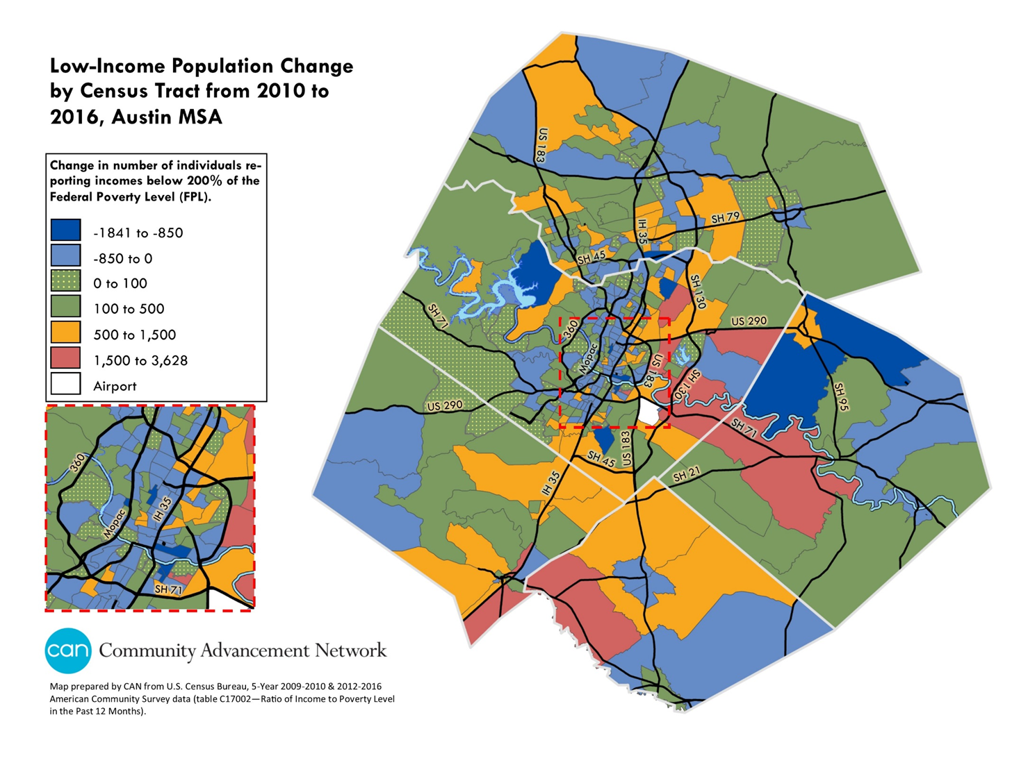
DEMOGRAPHICS
The Austin MSA topped 2 million for the first time in 2015
Travis County accounts for 1.2 million
About 25% of all people in the five-county MSA are “low-income”
$49,000 for a family of four with two adults
$39,000 for a family with two children and one adult.
In the areas shaded in orange, the low income population increased by more than 500
In the areas shaded in blue, the low income population increased by more than 1500
Notes:
The Austin MSA topped 2 million for the first time in 2015. Travis County accounts for 1.2 million of the 2 million.
About 25% of all people in the five-county MSA are “low-income.” What we mean by low-income is a family of four with two adults with an income of approximately $49,000 and a family of three with one adult with an income of approximately $39,000.
The map shows where we’ve seen the largest increase in low-income families in the 5-county region from 2010-2016. The orange shows an increase of between 500 and 1500 households. The red represents an increase of more than 1500 households.

Slide 6
DEMOGRAPHICS
The Austin MSA topped 2 million for the first time in 2015
Travis County accounts for 1.2 million
About 25% of all people in the five-county MSA are “low-income”
$49,000 for a family of four with two adults
$39,000 for a family with two children and one adult.
In the areas shaded in orange, the low income population increased by more than 500
In the areas shaded in blue, the low income population increased by more than 1500
Notes:
This chart summarizes the change in the number of low-income households by County. We see decreases in the number of low-income families in Travis and Williamson Counties and an increase in Hays County. Bastrop County pretty much remained flat.

Slide 7
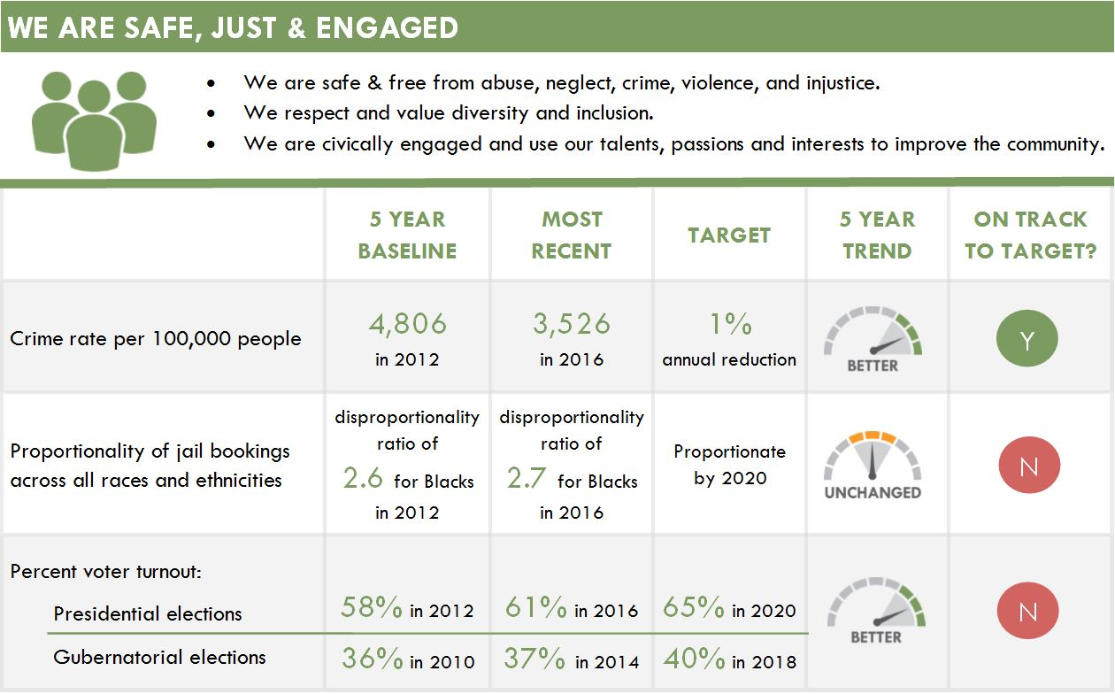
Notes:
We’ll now move on to the dashboard indicators themselves which may be found on pages 3 and 4 of the report. You’ll note that there are two ways that we gauge our current conditions on this summary sheet. First, we don’t report on the indicator for a single year. We track and report on the 5-year trend, which is the column with the gauges. We’ll report here if the 5-year trend is better, worse of unchanged. In the Safe, Just & Engaged we see that we are doing better with regard to crime and voting but not with regard to jail bookings where the trend is unchanged.
In addition to the 5-year trend, we also report in the last column, if we are on-track to meet the community goal that has been set for this indicator. We’ve met the target with regard to the crime rate but unless we improve the trend for the other two indicators, we will not meet the target that has been set.

Slide 8
HIGHLIGHTS
WE ARE SAFE, JUST & ENGAGED
CHALLENGES
Travis County Crime Declined
27%
From 2012 to 2016
African-American adults are
2.7 times as likely
To be booked into jail than Whites
Notes:
An area where we have seen great gains is with regard to the crime rate which has gone down 27% from 2012 to 2016. This greatly exceeds the goal of achieving a 1% reduction per year.
As previously mentioned, the jail bookings indicator is an area of concern. What does the jail bookings indicator mean exactly? It calls attention to the fact that while African Americans make up 8% of the population, they make-up 22% of the population that is booked into jail. It highlights the importance of focusing on criminal justice reform.

Slide 9
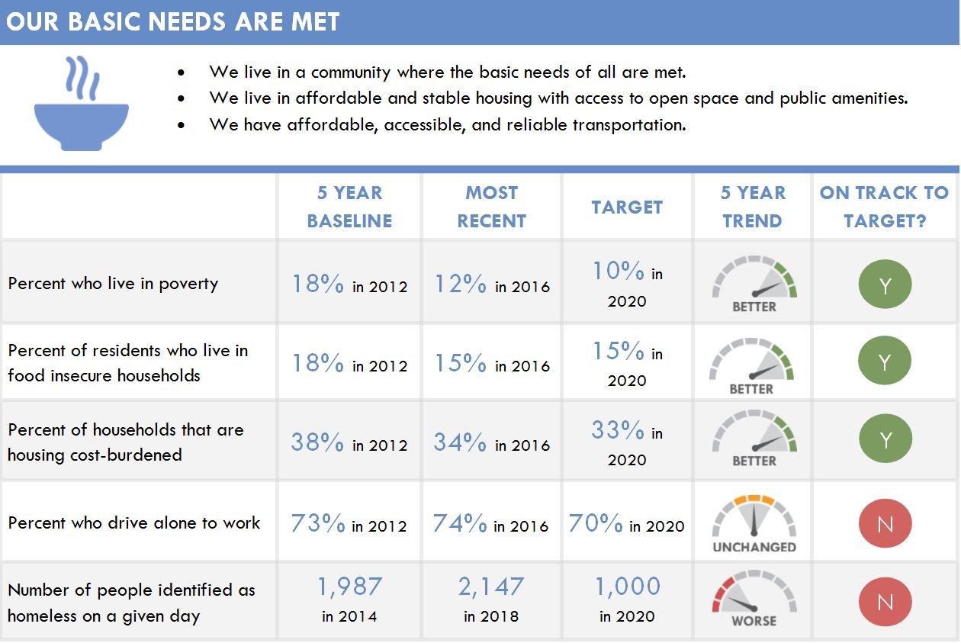
Notes:
There are five indicators in the Basic Needs section. Our five-year trends show poverty, food security and housing cost burdened improving. As you can see we are not making progress with regard to homelessness which saw a slight increase and our balance in transportation modes. About ¾ of us drive alone to work. That is important because it affects traffic congestion and it affects our air quality.

Slide 10
HIGHLIGHTS
OUR BASIC NEEDS ARE MET
CHALLENGES
In 2016, the Travis County Poverty Rate was 12 % (It was18% in 2012)
The Poverty Rate for African-Americans and Hispanics is
2 times higher
than it is for Whites
The Food Insecurity rate decreased to 15 % in 2016 (It was 18% in 2012)
63,780 children in Travis County were Food Insecure in 2016
(In 2012, that number was xx,xxx)
Notes:
Some highlights for this section are … [read the stats in the highlights box].
The challenges that we’ll highlight in this section relate to the two indicators we highlighted. If we look at poverty by race, we find that the poverty rate for Hispanics and African-Americans is twice as high. An issue that is further examined in the Equity Analysis section of the CAN Dashboard.
The challenge with food security comes into focus when we look at food access for children. While food security improved overall in Travis County, the level of food security for children actually worsened. [read stat in the challenges box]

Slide 11
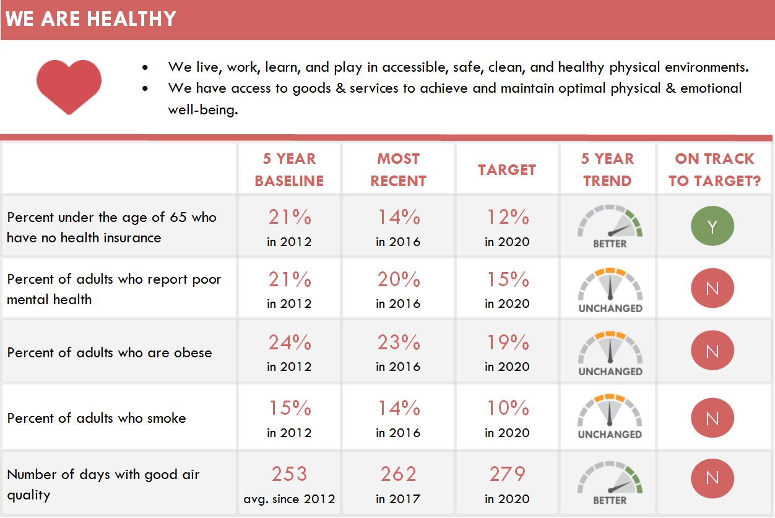
Notes:
There are five indicators in the “We are healthy” section of the CAN Dashboard.
With the exception of the indicator relating to health insurance, we didn’t see a lot of movement. The stats for mental health, obesity and smoking remained essentially flat. We did see a little movement in the right direction for Air Quality but it is not happening fast enough for us to meet our air quality goal.

Slide 12
HIGHLIGHTS
WE ARE HEALTHY
CHALLENGES
The health insurance rate for Travis County residents improved by
33%
From 2012 to 2016
While food access has improved from 18% to 15%,
The Obesity Rate remained essentially unchanged.
Suggesting that a focus on access to healthy food may be of import.
Notes:
An important point to highlight in the “We Are Healthy” section is the significant improvement we report for the rate of Travis County residents who have health insurance, which has improved by 33%. Given the recent changes to the Affordable Care Act, this is something on which we should continue to focus.
In the dashboard summary, we note that the obesity rate has remained essentially unchanged. We report a rate of 23% for 2016 and a rate of 24% five years prior to that. When we juxtapose the fact that we see an improvement in food security from 18% in 2012 to 15% in 2016, but that we are not seeing an improvement in the obesity rate, a conclusion that we might draw is that people may not be eating what is good for them. We need to eat healthier. And probably goes for each and every one of us.

Slide 13
Notes:
There are four indicators in the Achieving Our Full Potential section of the dashboard. Three are education related and one relates to employment. Outcomes in this section are quite mixed. One is unchanged, one is worse and two are better. But, we are only on track to meet one of the targets, specifically the unemployment rate. So, we’ll start with that indicator as a highlight. [go to next slide]

Slide 14
HIGHLIGHTS
WE ACHIEVE OUR FULL POTENTIAL
CHALLENGES
In 2016, the Travis County Unemployment Rate was 3 % (It was 7% in 2010)
The Unemployment Rate for African-Americans was
2 times higher
than it was for Whites
In 2016, the High School Graduation Rate
exceeded 90 % for the first time
49% of Central Texas students earn a degree in 6 years, compared to 31% of African-American students & 36% of Hispanic students
Notes:
Unemployment is at its lowest point since the unemployment rate peaked at 7% in 2010 as a result of the great depression. While high employment is positive, it also presents challenges since people looking for work find that the environment is very competitive and employers sometimes have trouble finding workers who are the right match. Another challenge relating to the unemployment rate is that we do see a disparity for African Americans in Travis County. (read the challenge Re unemployment]
On the education side, it is exciting that the graduation rate continues to trend upward. The rate has exceeded 90% for the first time in Central Texas. It is also encouraging that the achievement gaps have narrowed significantly. The graduation rates for African Americans and Hispanic students are approaching 90% whereas they were below 70% ten years ago.
When we consider Postsecondary Success, we see that significant gaps do exist. [Read stat in the slide for Blacks & Hispanics]. In the new economy, we know that earning a postsecondary credential is very important in terms of finding a good paying job, so this will be a critical issue to address going forward.

Slide 15
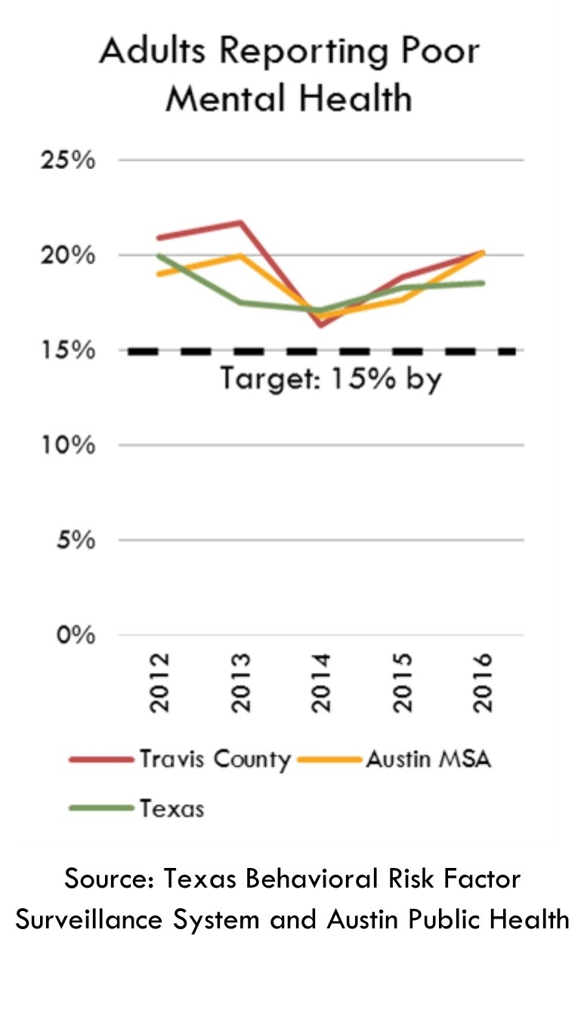
20%
of Travis County adults
REPORT POOR MENTAL HEALTH
Approximately 20% of Travis County residents reported experiencing five or more days of poor mental health over the past 30 days.
On days where someone is experiencing poor mental health, they may be experiencing stress, depression, and/or problems with emotions.
When we compare the 2016 rate of mental health to the 2012 rate, it appears that the rate has not changed much overall.
However, since the rate has increased two years in a row, the we should definitely monitor this trend.
Notes:
[Read the bullet points on the slide.]

Slide 16
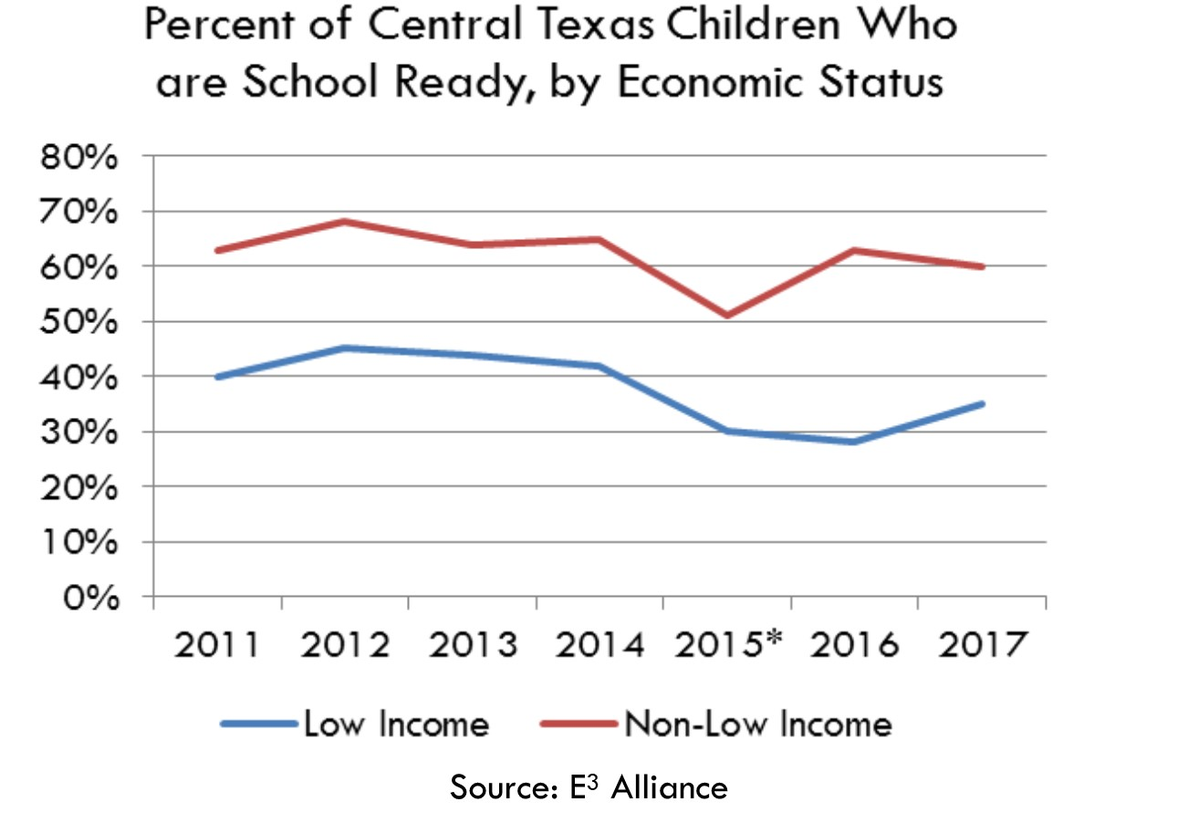
49
%
of Central Texas kindergarteners
ARE SCHOOL READY
In 2017, 49% of children entering kindergarten were school ready compared to 53% in 2013.
The greatest degree of disparity in school readiness occurs by income.
35% of low-income kindergarteners were school ready compared to 60% of non-low income kindergarteners.
Notes:
[Read the bullet points on the slide.]

Slide 17
WHAT STANDS OUT FOR YOU?
What did you learn that concerns you?
What did you learn that is “welcomed” news?
Did you learn something about what our community is doing to address this issue?
What else should be done?

Slide 18
SCHEDULE A PRESENTATION
contact
Jelina Tunstill jtunstill@canatx.org
or
Carlos Soto
csoto@canatx.org
visit
www.dashboard.canatx.org

